Slide 1
CUSTOMER CHURN ANALYSIS
Prepared by: Julius muendo musau
AnalystLab Africa Internship – Week 5

Slide 2
Business Problem
Customer churn is one of the biggest challenges faced by telecommunication companies. Losing customers results in reduced revenue, higher customer acquisition costs, and lower long-term profitability.
This project analyzes customer behavior to identify the key drivers of churn and provides data-driven recommendations to improve customer retention.

Slide 3
Dataset Overview
Dataset: Telco Customer Churn Dataset
Source: Kaggle
Dataset Size:
• 7,043 Customers
• 21 Features
Fields include customer demographics, services subscribed, contract type, payment method, monthly charges, total charges, tenure, and churn status.
Tools Used:
Python
Pandas
Matplotlib

Slide 4
Key Insights
Month-to-month contracts recorded the highest customer churn.
Fiber optic customers experienced higher churn than DSL customers.
Customers with shorter tenure were significantly more likely to leave.
Customers with higher monthly charges showed a greater likelihood of churning.
Senior citizens exhibited a relatively higher churn rate than non-senior customers.

Slide 5
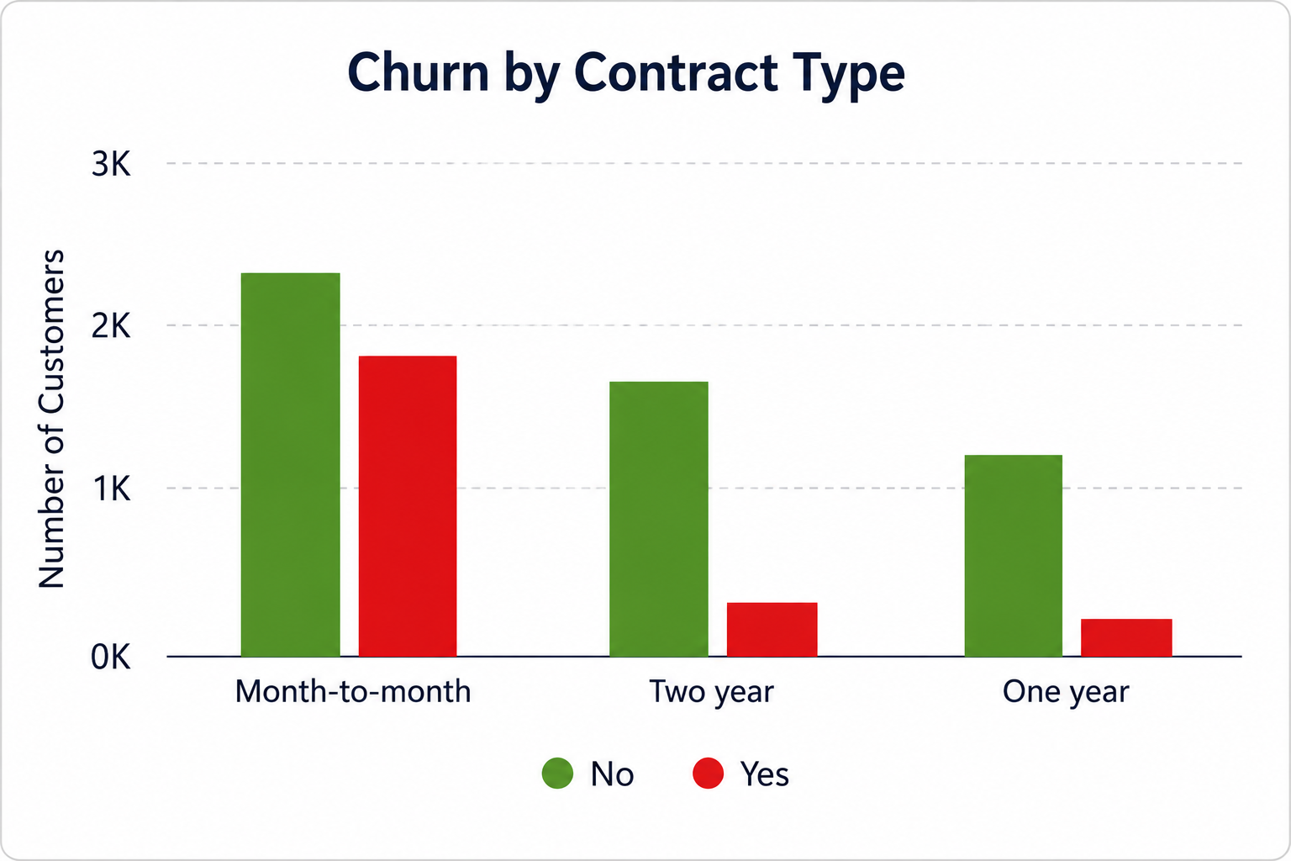
Churn by Contract Type

Slide 6
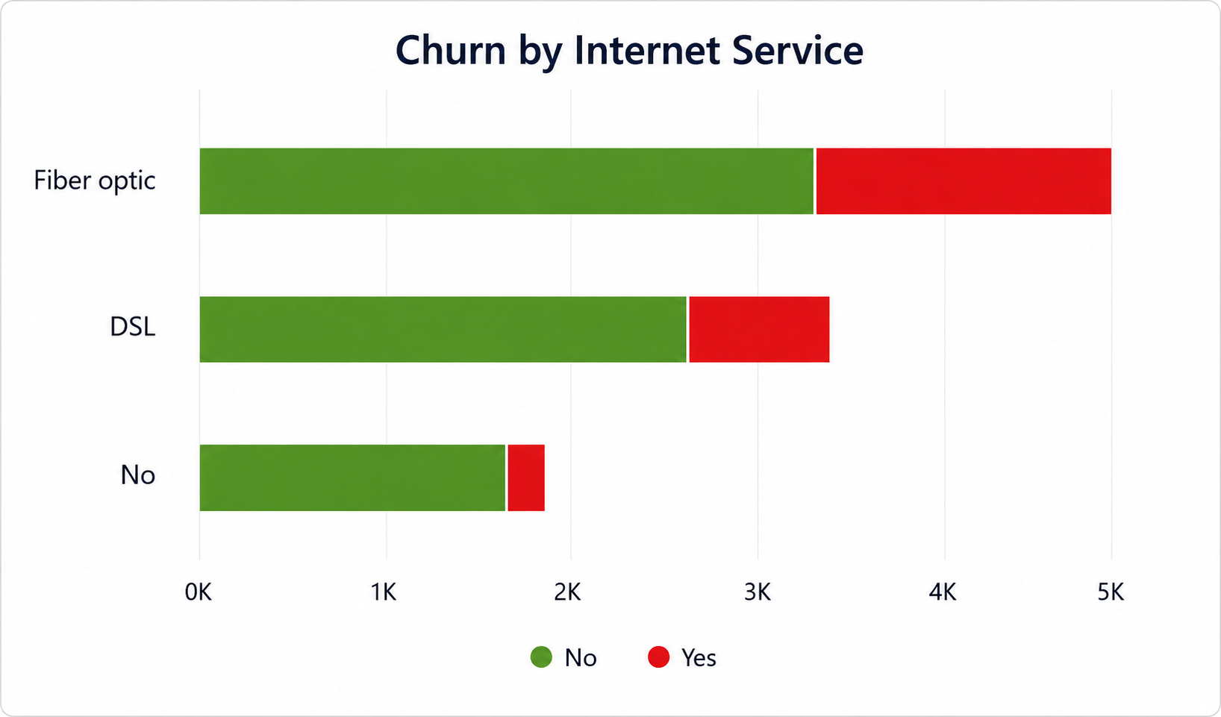
Churn by Internet Service

Slide 7
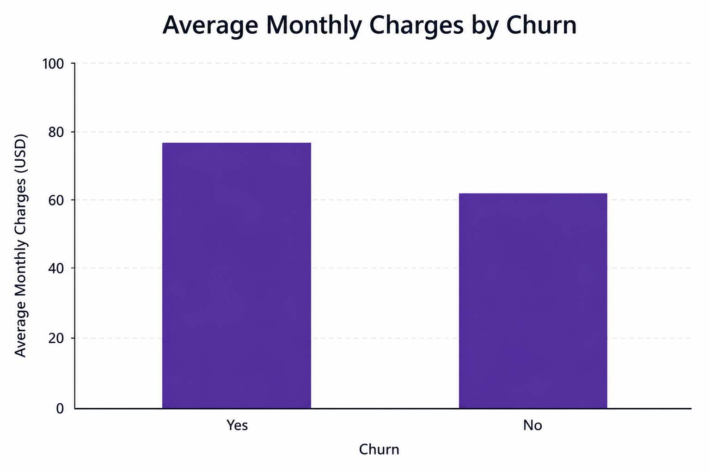
Average Monthly Charges by Churn

Slide 8
Recommendations
Encourage customers to migrate to long-term contracts through targeted incentives.
Improve customer retention strategies for Fiber Optic subscribers.
Strengthen customer engagement during the first year of service.
Introduce loyalty rewards for high-risk customer segments.
Continuously monitor churn trends using interactive dashboards.

Slide 9
Conclusion
The Customer Churn Dashboard transformed raw customer data into meaningful business insights.
The analysis identified the key factors influencing customer churn and provided practical recommendations that can support customer retention and improve business performance through data-driven decision-making.

